Slide 1
1,000 APPRENTICE ACHIEVERS
Digital Toolkit – INTERNAL

Slide 2
Summary
The Energy & Utilities Independent Assessment Service (EUIAS) has passed its 1,000th learner on the new English apprenticeship standards.
Below is a summary of the marketing activity that will be taking place the week commencing 24 June 2019 to showcase this achievement:
Social media posts on EUS Twitter, LinkedIn, EUIAS LinkedIn Showcase Page
Press release
Web article added to EUS and EUIAS websites
Case study of 1000th achiever uploaded on EUIAS site
Email Banner
EUIAS email to key contacts
This internal digital toolkit that can be used by colleagues to support our social media activity to amplify our messaging to maximise our impact.

Slide 3
Social Media Guidance
The hashtag for the campaign is #EUIAS1000 please use this on any message you share.
Posts from colleagues on any social media channel should use this hashtag as well as tagging* the correct company profile (see below for links).
Twitter (@EUSkills) – click on the link to see our twitter feed & follow. Colleagues on Twitter can retweet any tweets regarding the 1000th apprentice.
LinkedIn (Energy & Utility Skills) – click on the link to view our profile & follow. Colleagues on LinkedIn can share any posts regarding the 1000th apprentice.
LinkedIn Showcase Page (Energy & Utilities Independent Assessment Service) – click on the link to view our profile & follow. Colleagues on LinkedIn can share any posts regrading the 1000th apprentice. In order to drive traffic to this page, colleagues are encouraged to share any posts to support this campaign from the IAS LinkedIn page instead of EUS.
*If you require any further advice or guidance on tagging please speak to a member of the digital marketing team.

Slide 4
Social Posts (Twitter)
Twitter:
Today marks a special day for the EUIAS as they have reached a milestone of 1000 apprentice achievers! To find out more about our 1000th achiever from @SPEnergyNetwork visit: http://bit.ly/EUIAS1000 | #EUIAS1000 #RobustRigorousReady
The EUIAS is celebrating 1000 apprentice achievers passing through end-point assessment. Congratulations to apprentice Jonathan Li from @SPEnergyNetwork. Find out more about our 1000th apprentice here: http://bit.ly/case1000 | #EUIAS1000 #RobustRigorousReady

Slide 5
Social Posts (LinkedIn)
LinkedIn:
Today marks a special day for the Energy & Utilities Independent Assessment Service (EUIAS) as we have reached a milestone of 1000 apprentice achievers! To find out more about our 1000th achiever from ScottishPower Energy Networks and read our press release visit: http://bit.ly/EUIAS1000 | #EUIAS1000 #RobustRigorousReady
The Energy & Utilities Independent Assessment Service (EUIAS) is celebrating 1000 apprentice achievers passing through their end-point assessment service. To find out more about the 1000th apprentice, Jonathan Li from ScottishPower Energy Networks, read his story here: http://bit.ly/case1000 #EUIAS1000 #RobustRigorousReady

Slide 6
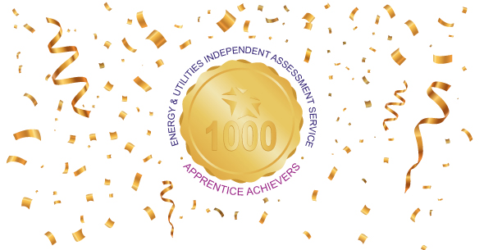
Social Graphics
The graphics below are to be used in conjunction with the social posts to support the campaign:

Slide 7
Useful Links
1000 Achievers Press Release >
On EUIAS site > http://www.euias.co.uk/2019/06/25/service-leaver-is-1000th-apprentice-to-graduate-through-leading-end-point-assessment-body/
On EUS site > https://www.euskills.co.uk/2019/06/25/service-leaver-is-1000th-apprentice-to-graduate-through-leading-end-point-assessment-body/
1000th Achiever Case Study >
http://www.euias.co.uk/case-study-jonathan-li-sp-energy-networks/
EUIAS LinkedIn Page
EUS Twitter
SPEN Twitter
SP LinkedIn

